Slide 1
Raffles in Michigan
Raffle Basics for Non-Profit Organizations

Slide 2
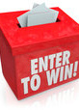
Qualification requirements
The law allows qualified non-profit organizations to be licensed to conduct bingos and raffles, and to sell charity game tickets. Organizations that have not previously qualified must provide the appropriate qualification documents.
In Michigan there are 7 different organization types that may qualify. All have a slightly different qualification document to submit.
  Educational
  Fraternal
  Local Civic
  Religious
  Senior Citizen
  Service
  Veteran
An organization may go through qualification before applying for a license or submit qualification documents along with license fees and completed license applications.

Slide 3
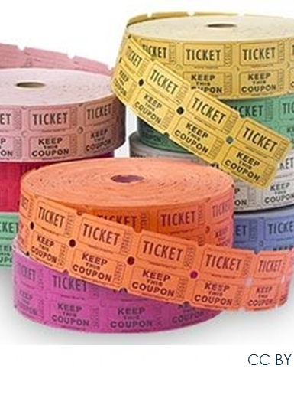
What is a raffle?
A raffle is an event where raffle tickets are given or sold and at least one winner is determined by a drawing. All drawings that take place under one license must be at the same location. A raffle CANNOT take place during a licensed bingo event but CAN occur before or after the time listed on the bingo license.
If unsure of whether you’re conducting a raffle or not, contact us to assist you in that determination.

Slide 4
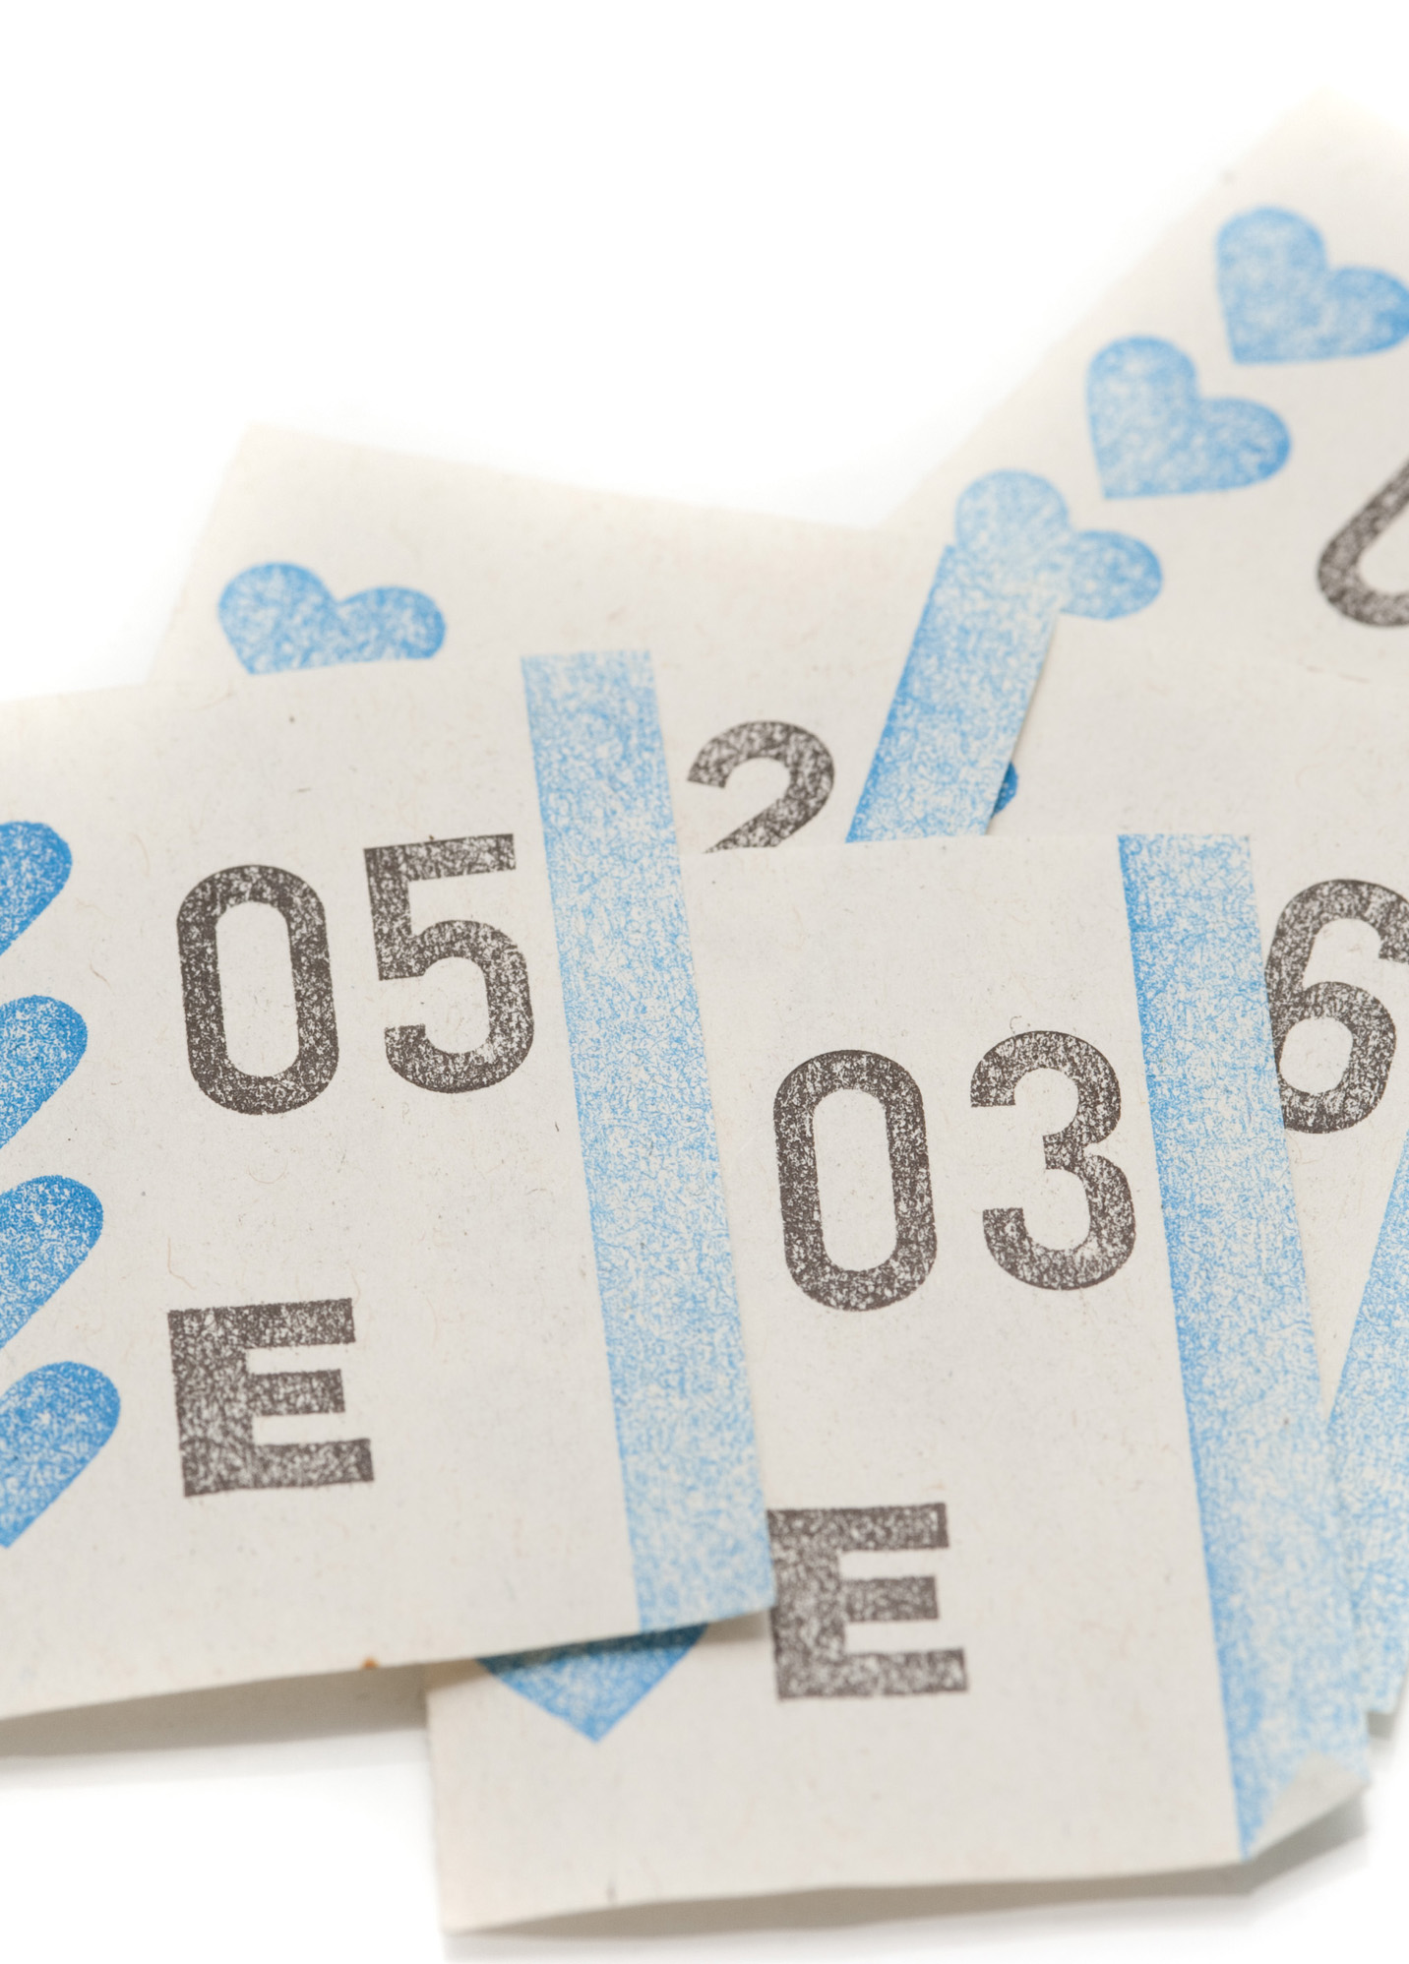
Are there any raffles that don’t require a license?
Yes, there is an “Exempt Raffle” that does not require a license. The following items must be met to qualify:
The organization is currently qualified by the Charitable Gaming Division.
The raffle will be held at a single gathering of the organization (primary purpose must be something other than the raffle).
All tickets will be sold, drawing held, and prizes awarded at the single gathering (no pre-sale).
Total value of all prizes awarded for the entire day will not exceed $100.

Slide 5
Conducting a raffle
The State has a very comprehensive Raffle Guide (link below) where the details of conducting a raffle can be found. Key components of conducting a raffle include:
  Selecting who is responsible; principal officer and chairperson
  Preparing the tickets; pre-printed, pre-bundled and/or pre-packed
  Accountability of tickets and cash
  Conducting the raffle; the drawing, awarding prizes
  https://www.michigan.gov/documents/cg/BSL-CG-1824_664391_7.pdf

Slide 6
Follow up with the
De boer, Baumann & COMPANY P.L.C. team for assistance
WWW.DBCNPO.COM
Anne Porter aporter@dbccpa.com 616-396-1435
Carol Burley cburley@dbccpa.com 616-846-3350
Jessica Holzinger jholzinger@dbccpa.com 616-846-3350
Kaileigh Eddy keddy@dbccpa.com 269-637-7311

